Slide 1
TED_TALKS CLUSTERING
V BHAVESH
D SAIDU
N ABHIRAM

Slide 2
DATASET
Given dataset has 2475 rows and 123 columns or dimensions.
Here we need to find clusters or groups from given data.
Every column will not contribute to form clusters.
So remove unnecessary columns and normalize data like duration into seconds.
Since we have data that has ‘NaN’ values, we need to take care of it by removing or replacing with most common value or by mean.
We replaced ‘NaN’ values with mean.
The data we have varies largely in range.
So we need to do feature scaling to normalize whole dataset.

Slide 3
Why k-means? Why not Hierarchical Clustering?
Because K-Means performs better than Hierarchical Clustering on large datasets.
Finding optimal number of clusters using dendograms in Hierarchical Clustering is harder than using Elbow method in K-Means

Slide 4
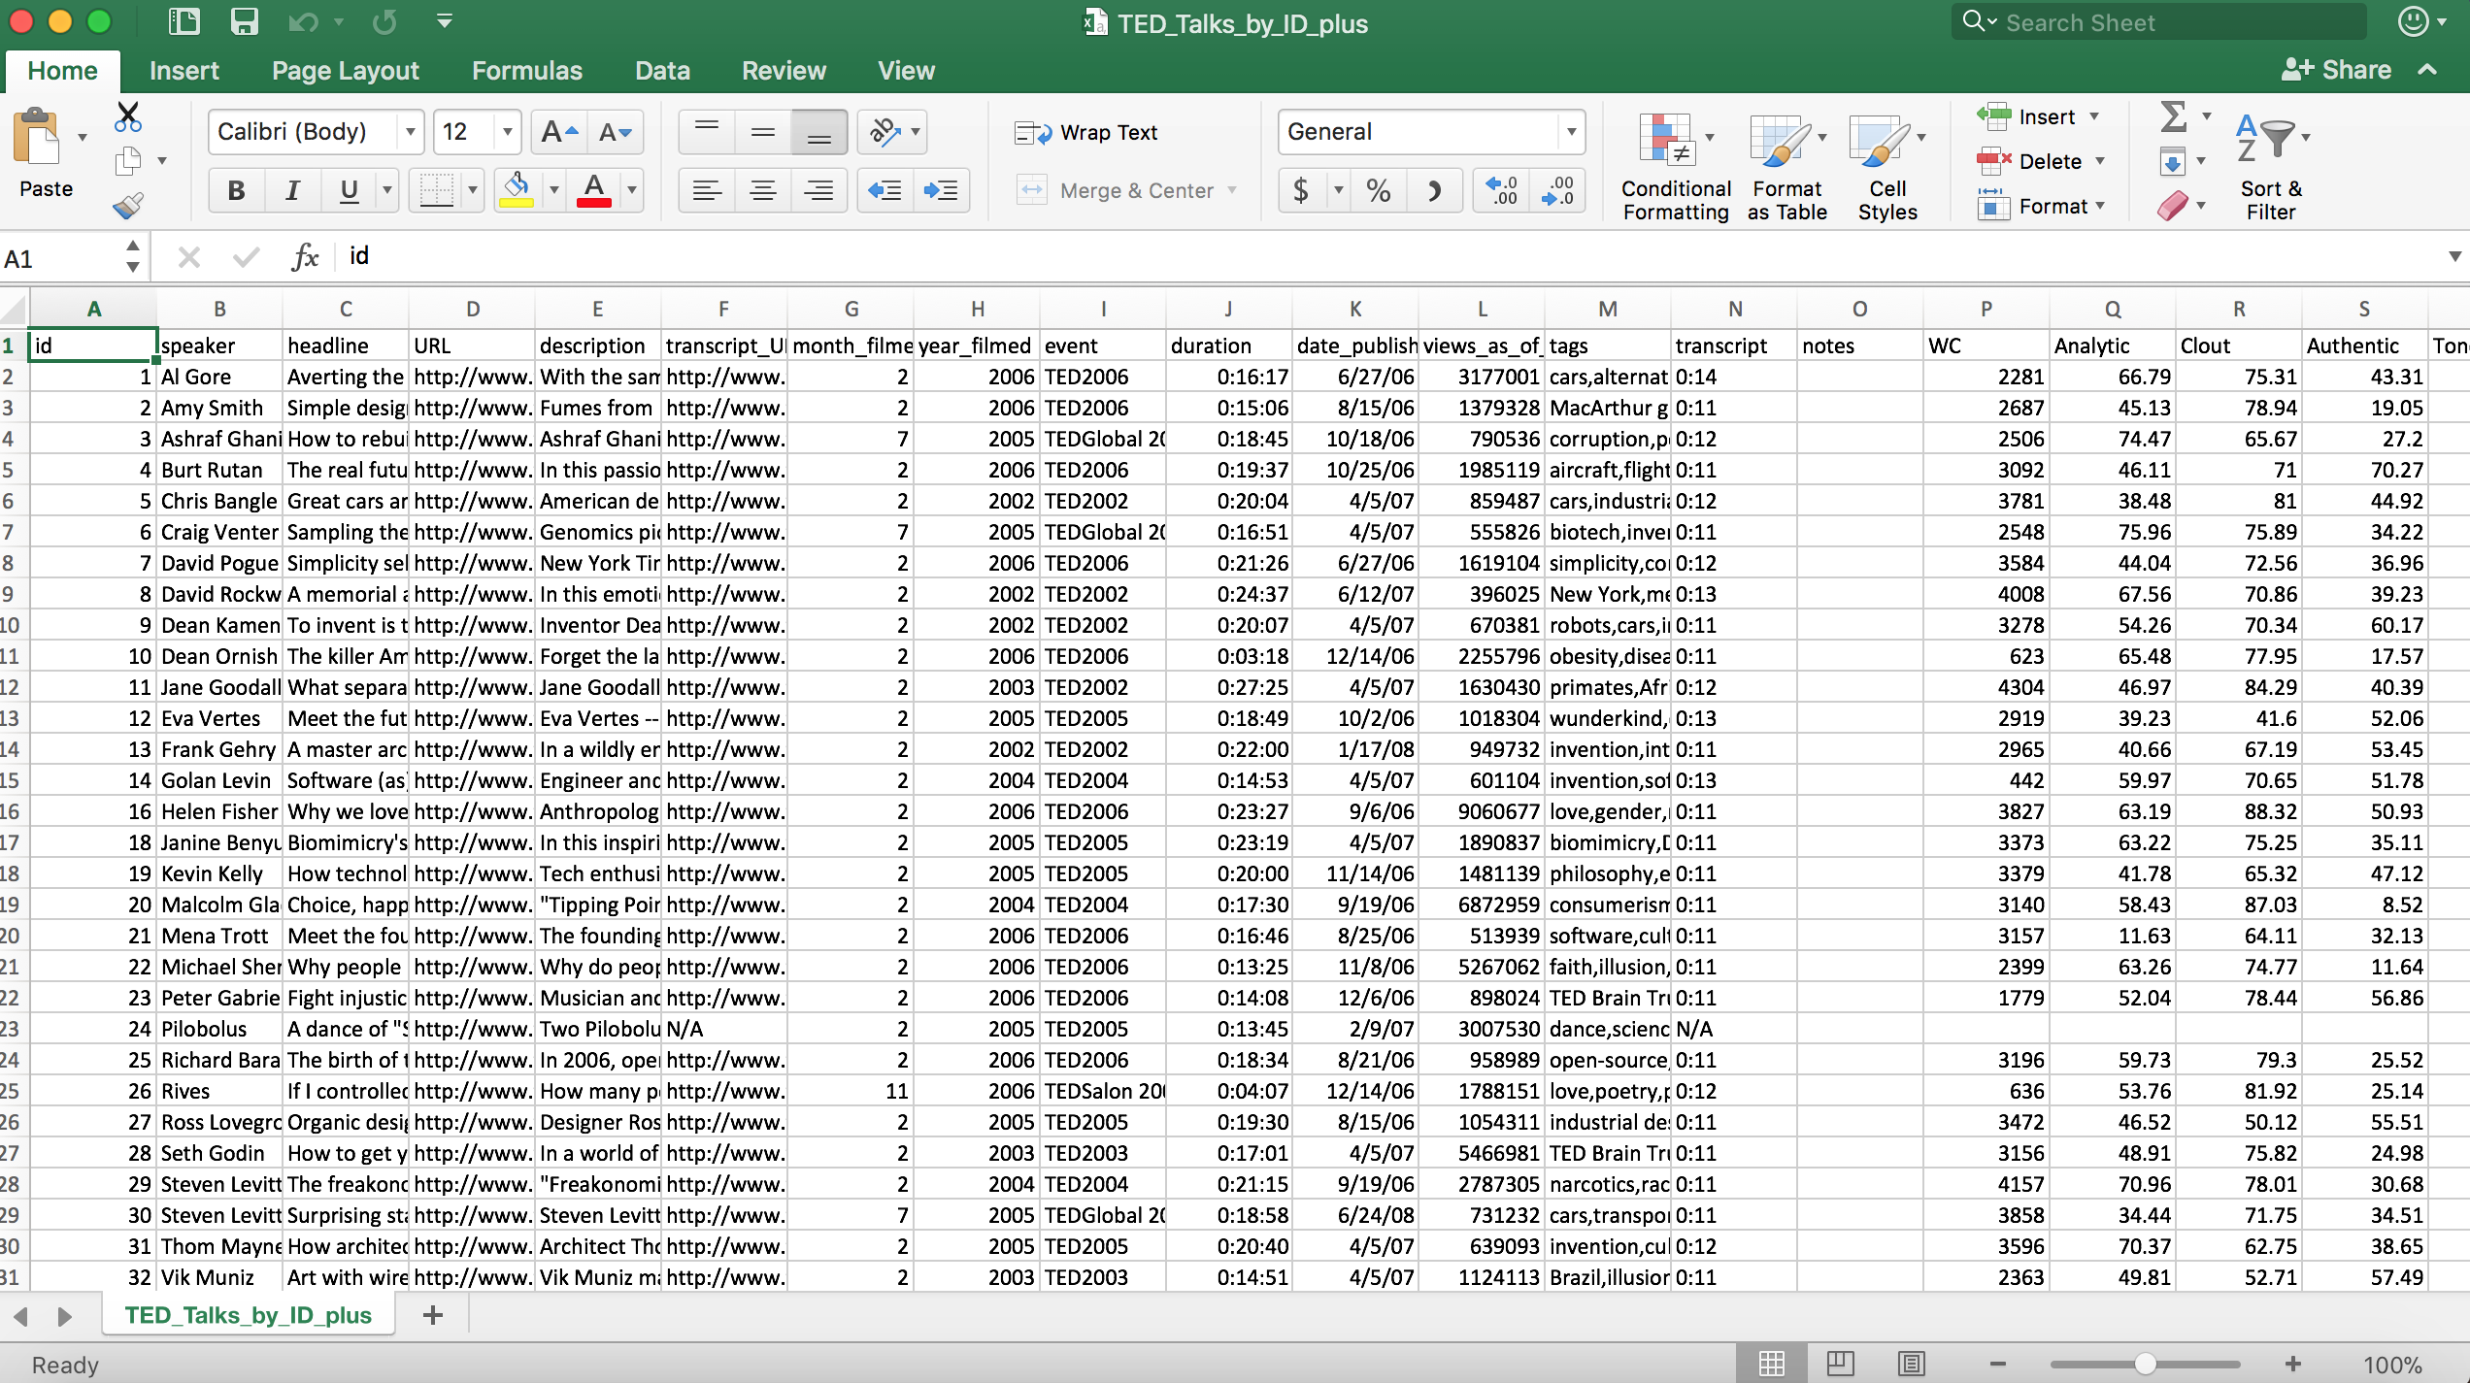
Input Dataset

Slide 5
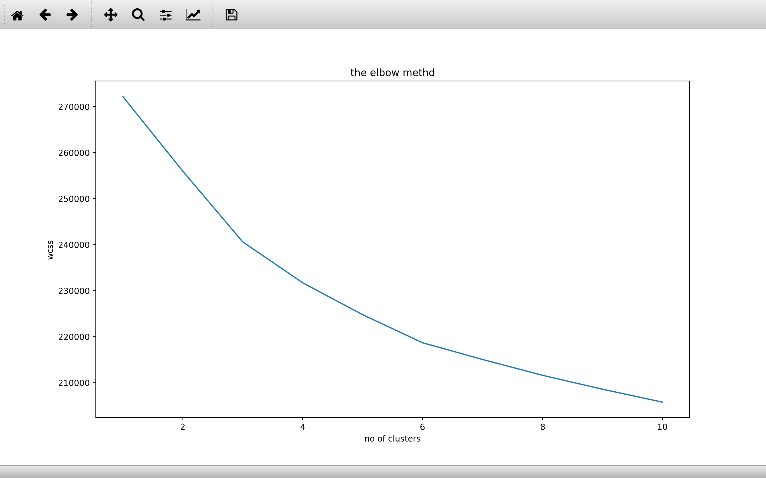
Finding Optimal no of clusters
Elbow Method in K-Means: optimal is 6

Slide 6
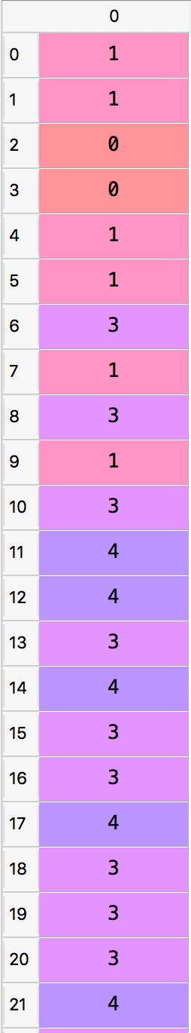
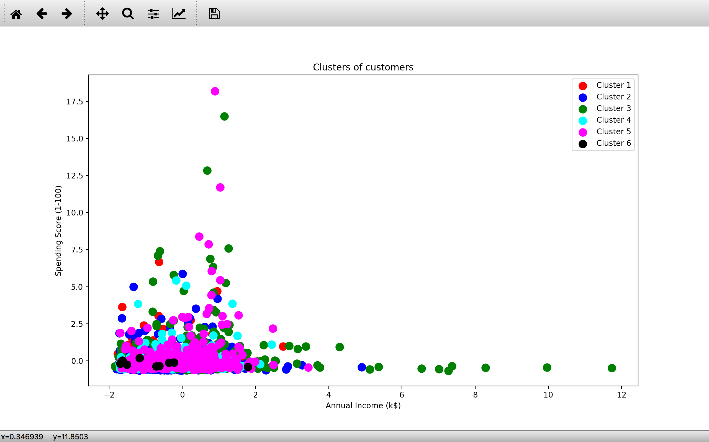
Output (k-means)
Test Data resulting the clusters
Cluster 2
Cluster 1
Cluster 4
Cluster 5

Slide 7
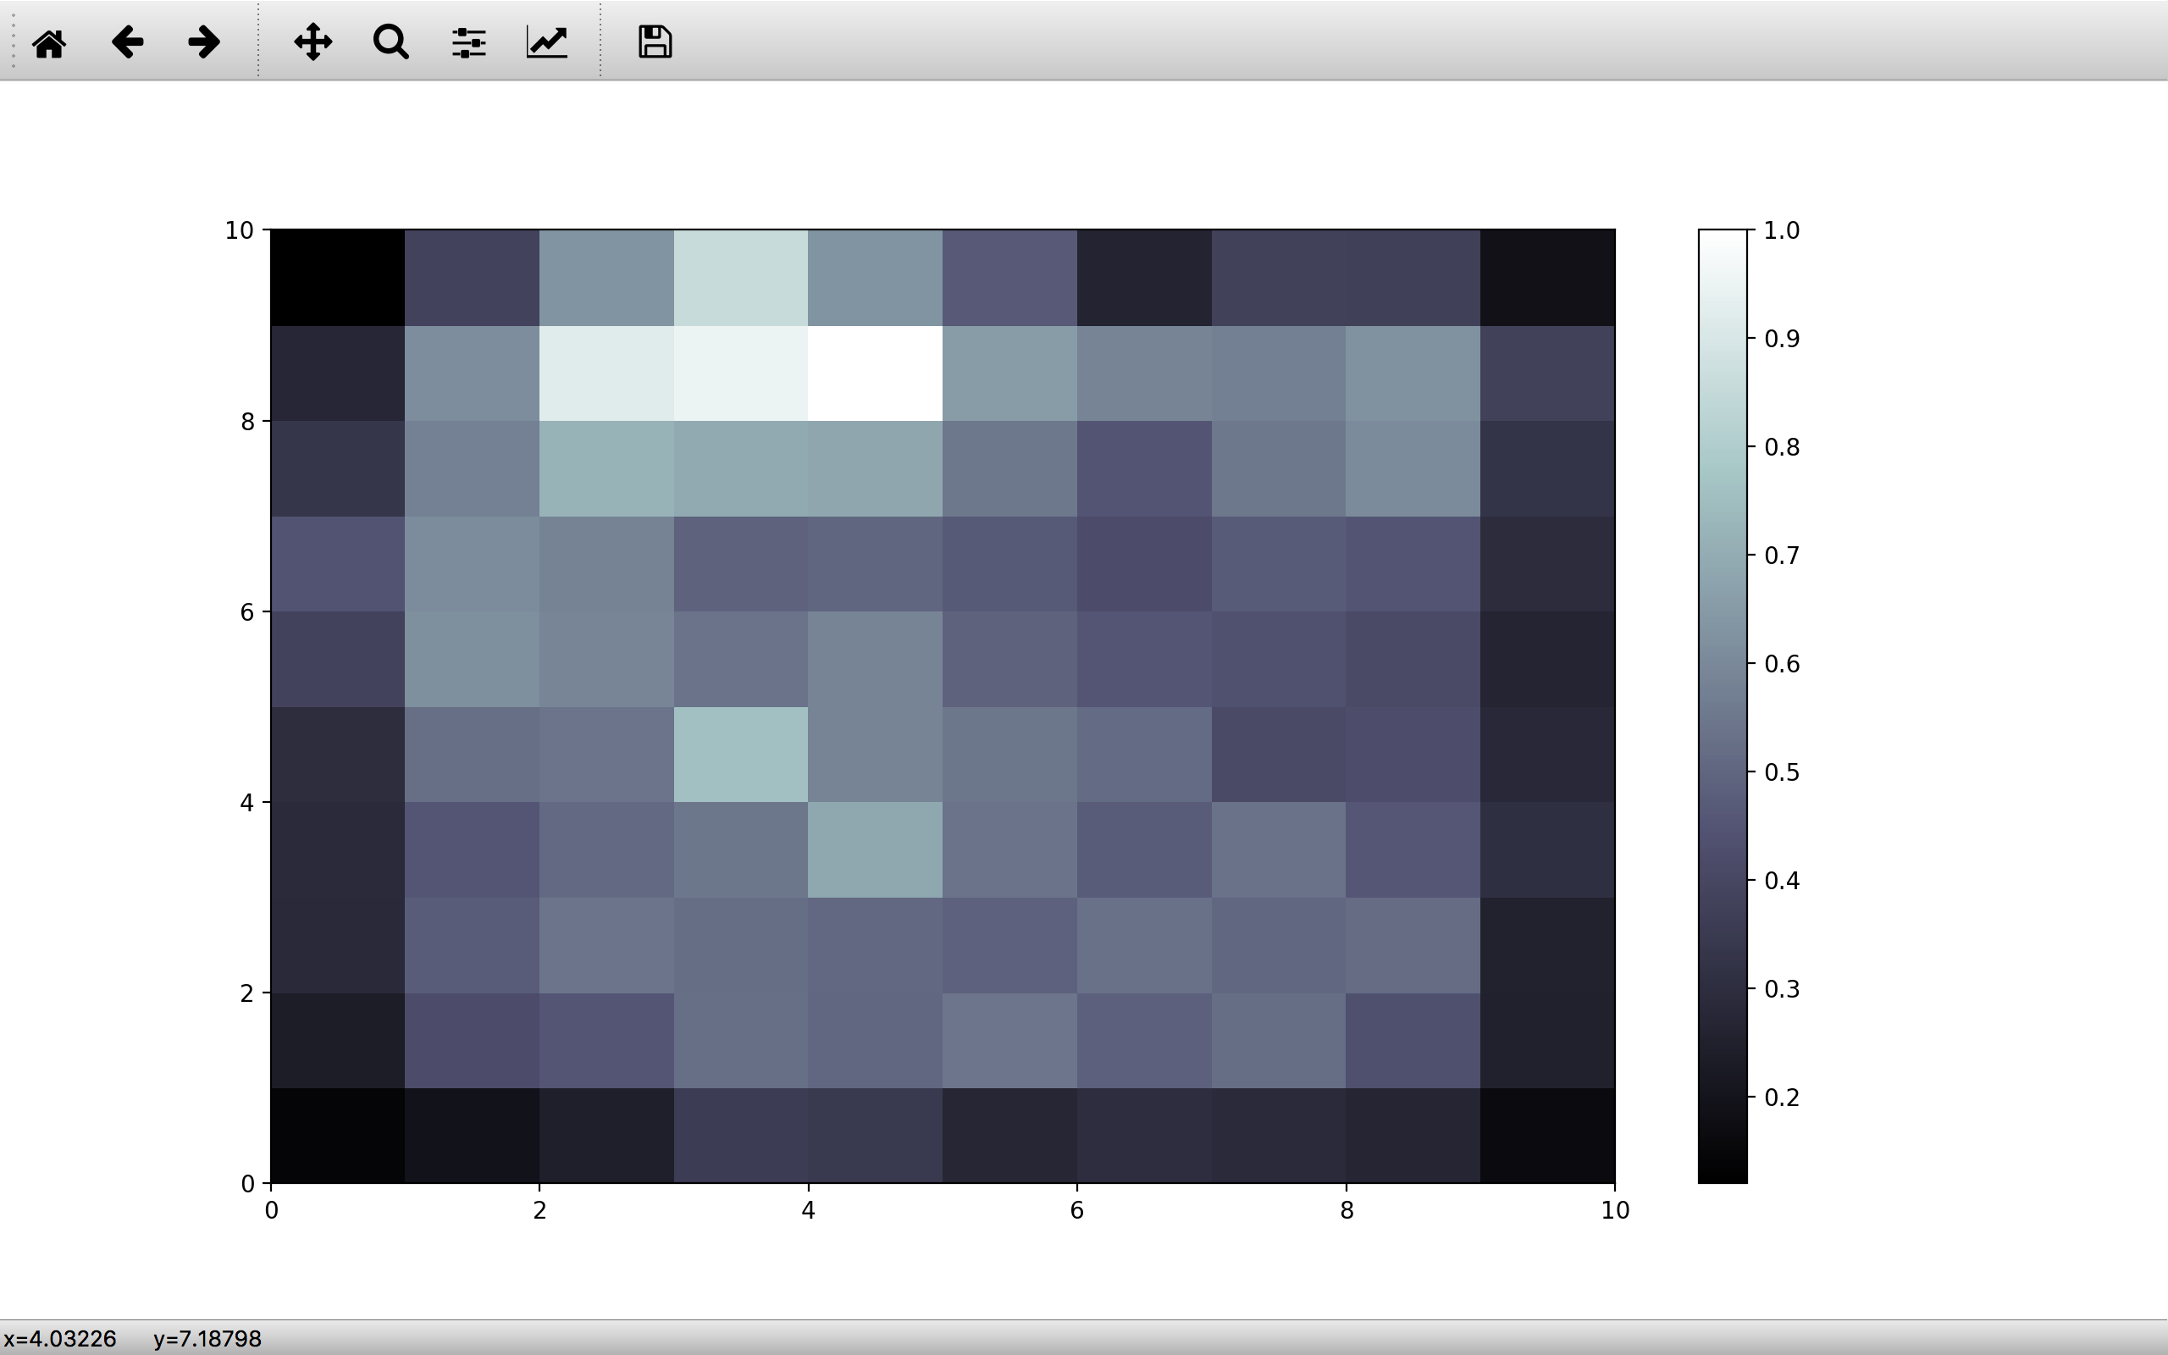
Output (self-organizing maps)

